Slide 1
Online Bookstore Application: A Web-Based Book Shopping Platform
Developed using:
Frontend: HTML, CSS, JavaScript
Backend: Java, Maven
IDE: Eclipse

Slide 2
Abstract
The Online Bookstore Application is a comprehensive web-based platform that allows users to browse, search, and purchase books online. This system provides a user-friendly interface for customers to explore a wide collection of books across different genres, manage their shopping cart, and complete purchases seamlessly.
The application features user registration and authentication, dynamic book search and filtering, real-time cart management, and a secure checkout process. Built with modern web technologies, it combines a responsive HTML/CSS/JavaScript frontend with a robust Java backend, ensuring smooth performance and excellent user experience.

Slide 3
Existing System
Many existing online bookstore systems rely on outdated interfaces and limited features, making them less user-friendly.
Inventory often isn’t synced in real time, leading to incorrect availability information or sudden out-of-stock disappointments.
Search and filter capabilities may be weak or absent, so finding books by title, author or genre becomes time-consuming.
Shopping cart and checkout features may not be optimized for persistent sessions or updating quantities dynamically.
Many sites lack full responsiveness, meaning the user experience on tablets or mobiles is sub-par.

Slide 4
Proposed System
Secure user registration and login enable personalized accounts, allowing users to manage profiles, view history, and enjoy tailored experiences.
A comprehensive browsing interface shows detailed book information (title, author, genre, price, cover image) and supports advanced search and filtering, making discovery faster and easier.
Shopping cart functionality supports adding/removing books, updating quantities in real time, showing totals including shipping, and maintains the cart across different sessions—offering flexibility and convenience.
Fully responsive design ensures the site works seamlessly on desktops, tablets and mobile devices; users can browse and purchase anytime, anywhere.

Slide 5
Advantages
24/7 Availability -Shop anytime, anywhere with internet access
No time restrictions or store closing hours
2. Convenience -No need to travel to physical stores
Shop from comfort of home
Save time and transportation costs
3. User-Friendly Interface -Simple navigation and clean design
Quick search and filter options
Easy cart management
4. Secure Transactions -Protected user authentication
Session-based security
5. Cost-Effective -Reduced operational costs for bookstore
Competitive pricing for customers

Slide 6
Disadvantage
1. Internet Dependency
Requires stable internet connection
Cannot function offline
2.No Physical Inspection
Cannot physically examine books before purchase
Rely on descriptions and images only
3.Shipping Time
Delivery takes time compared to immediate purchase
Additional shipping costs
4.Technical Knowledge
Users need basic computer/smartphone skills
May be challenging for elderly or non-tech-savvy users

Slide 7
Hardware Requirements
For Development:
Processor: Intel Core i3 or equivalent (2.0 GHz or higher)
RAM: 4 GB minimum (8 GB recommended)
For Server Deployment:
Processor: Intel Core i5 or equivalent
RAM: 8 GB minimum
Storage: 50 GB available space
Network: Stable internet connection (10 Mbps or higher)
For Client (End Users):
Any device with web browser (PC, laptop, tablet, smartphone)
Minimum 2 GB RAM

Slide 8
Software Requirements
1.IDE
Eclipse IDE for Java Developers
2.Programming Languages
Java (JDK 11 or higher)
HTML5
CSS3
JavaScript (ES6+)
3.Build Tool
Maven
4.Web Browser
Google Chrome, Mozilla Firefox, Microsoft Edge, or Safari (latest versions)

Slide 9
Modules
User Authentication Module
User Registration
User Login
User Logout
Session Management
Book Management Module
Display All Books
Search Books
Filter by Genre
View Book Details
Shopping Cart Module
Add to Cart
Update Quantity
Remove from Cart
Clear Cart
Calculate Total

Slide 10
Module Description
1. User Authentication Module
Purpose: Manages user accounts and secure access to the system
Components:
Registration: Creates new user accounts with username, email, password, and full name
Login: Authenticates users and creates session tokens
Logout: Terminates user sessions securely
Session Management: Maintains user state across pages using tokens

Slide 11
2. Book Management Module
Purpose: Handles all book-related operations and displays
Components:
Book Display: Shows all available books with details (title, author, genre, price, description, stock)
Search Functionality: Real-time search across title, author, and genre
Genre Filter: Displays books filtered by specific genres
Book Repository: In-memory storage with pre-loaded sample books

Slide 12
3. Shopping Cart Module
Purpose: Manages user's selected items for purchase
Components:
Add to Cart: Adds books with specified quantity
Update Quantity: Increases or decreases item quantity
Remove Item: Deletes specific book from cart
Clear Cart: Removes all items at once
Total Calculation: Computes subtotal and total with shipping

Slide 13
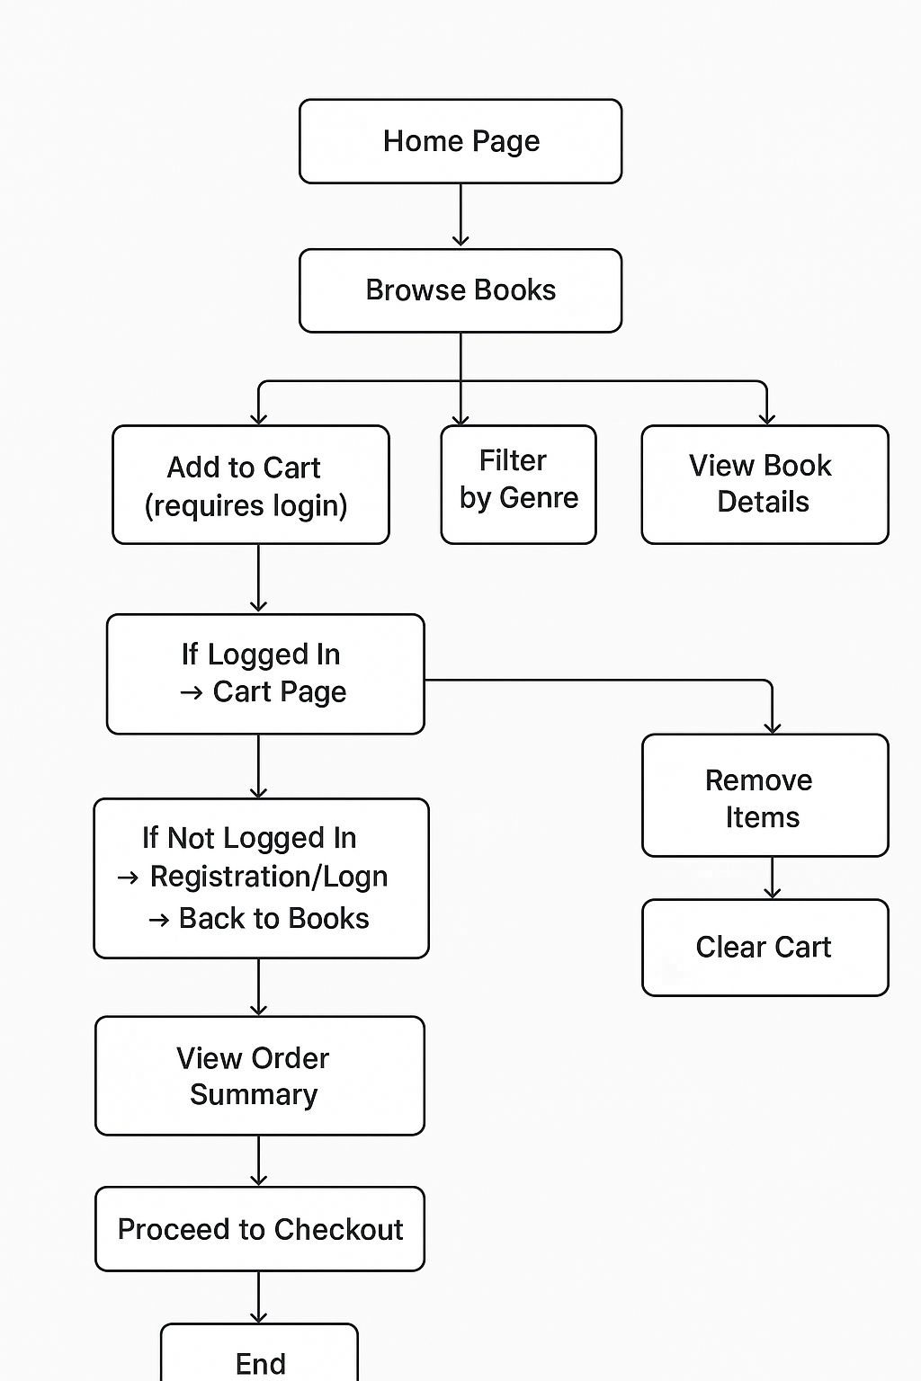
System Flow

Slide 14
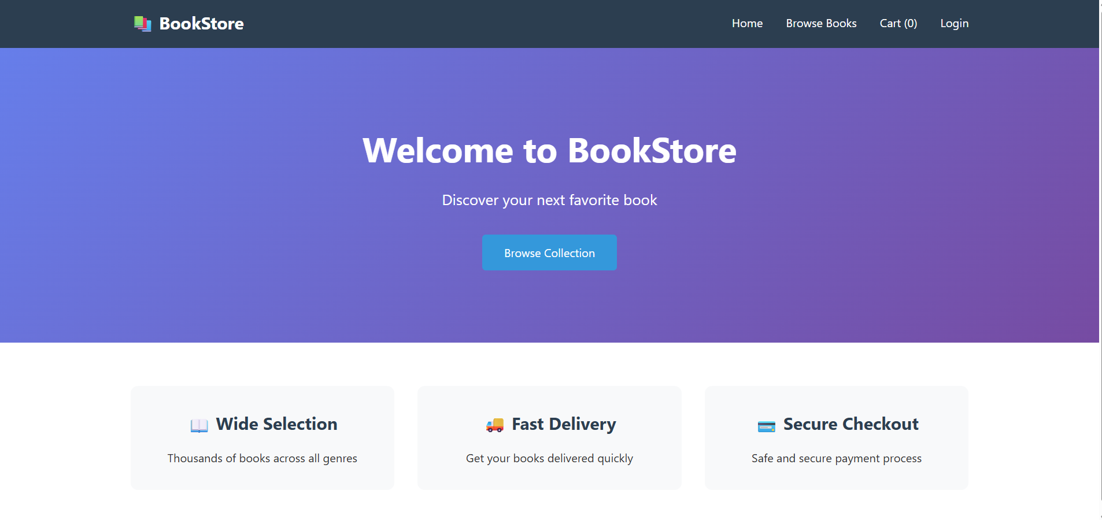
Sample Output

Slide 15
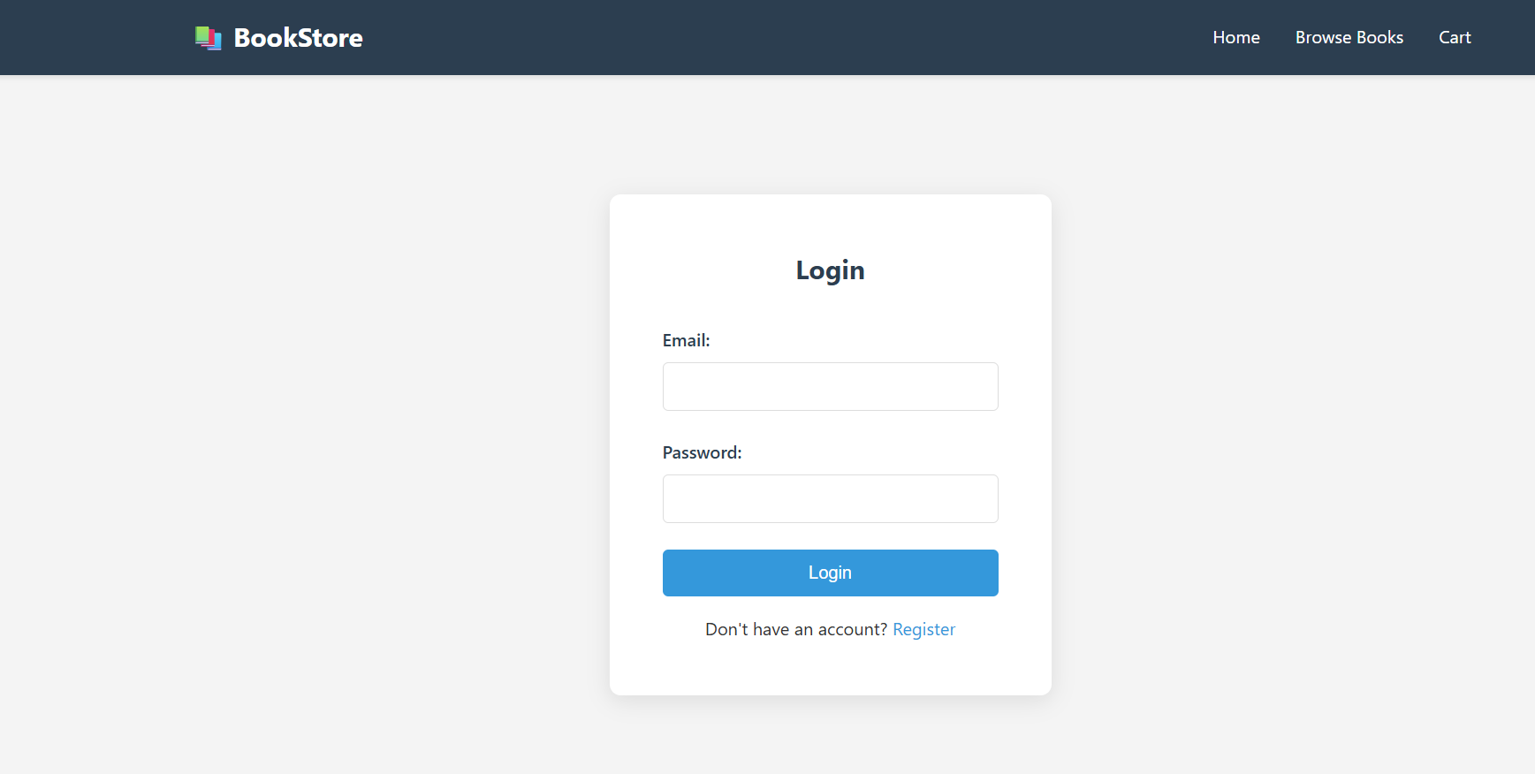
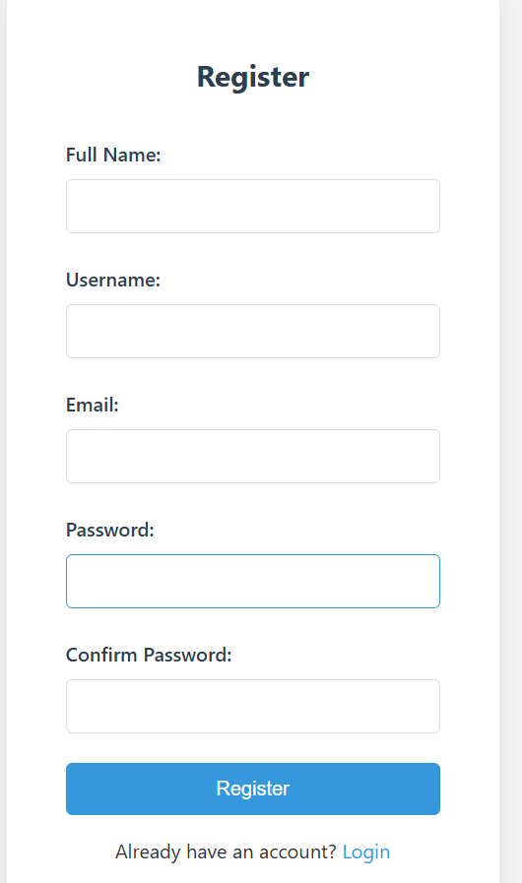

Slide 16
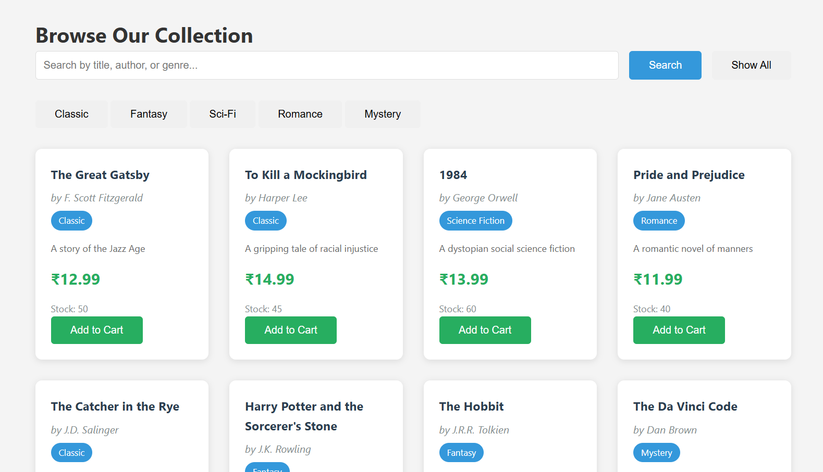

Slide 17
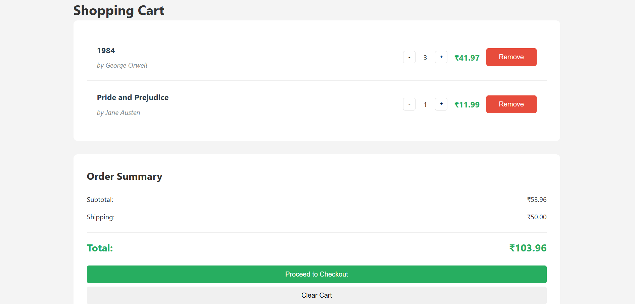

Slide 18
Conclusion
The Online Bookstore Application successfully demonstrates a fully functional e-commerce platform for book shopping. The system provides an intuitive and user-friendly interface that simplifies the book purchasing process.
Key achievement: I developed a secure user registration and authentication system, implemented dynamic book browsing with search and filter options, and built real-time shopping cart management. The application features a responsive design for all devices and a RESTful API backend to ensure smooth and scalable functionality.
Learning Outcomes: By completing the project, I will be able to build a full-stack web application using Java and web technologies, design and implement RESTful APIs, manage session-based user authentication, integrate frontend and backend components, and handle project management with Maven

